Slide 1
PaaS to your Rescue
Do No more, Any more!
Prasanna Jaganathan

Slide 2
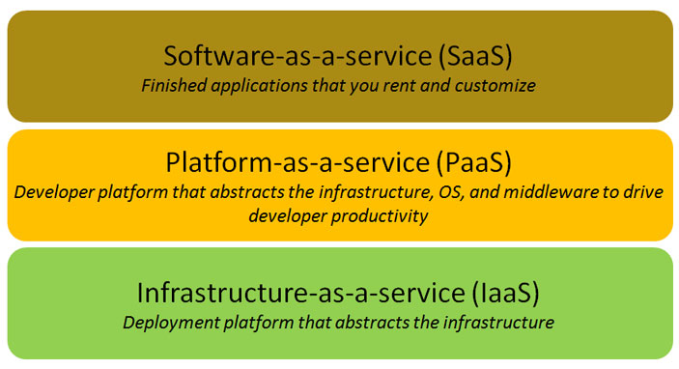
The Cloud Stack

Slide 3
Forrester PaaS Comparison Matrix

Slide 4
A Walk in the Clouds

Slide 5
A Walk in the Clouds
A simple CRM process

Slide 6
OrangeScape PaaS
Cloud Deployment
Write Once, Cloud Anywhere
Studio
Enterprise Deployment

Slide 7
Rugged, time tested platform
2003
2004
2005
2006
2007
2008 Q1, Q2
2009 Q1
Product R&D
Initial Major Release
R1.0
R1.1
R2.0, R2.1
R2.2, R2.3
R2.4
R3.0 Beta release
Enterprise Portal
SAP Connector
Workflow Engine
Reporting Engine
Enterprise Data Load
Adhoc Reporting
Custom Editor
Platform As A Service (PaaS)
Browser based development
Support for Cloud Datastore (BigTable)
Eight public releases made since 2003
Latest version - 3.0

Slide 8
Join the walk for the next 20 minutes
Step 1 : Elaborate Requirements
Step 2 : Prepare Data Modeling
Step 3 : Design Models, Forms & Process flow in Studio
Step 4 : Deploy the app on GAE
Step 5 : Get ready to test your application on cloud
CRM Application

Slide 9
Demo
Notes:
9

Slide 10
Are you a SaaS entrepreneur?
Free to
Develop
Collaborate
Test
Show Case
Pay when you earn!

